Slide 1
DevOps Project Kubernetes Deployment
Made By : Bhushan Sawant

Slide 2

Built Kubernetes Cluster with Minikube.
Setup and Managed Docker Containers for Django and React applications into Kubernetes Pods.
Managed Deployment, Replication, Auto healing, Auto scaling for Kubernetes Cluster.
Managed Network and Services with Host IP allocation.

Slide 3
Achievements:
Reduced downtime on production environment.

Slide 4
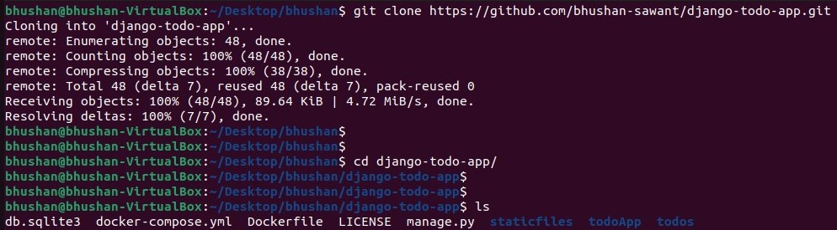
Setting up project on local instance

Slide 5
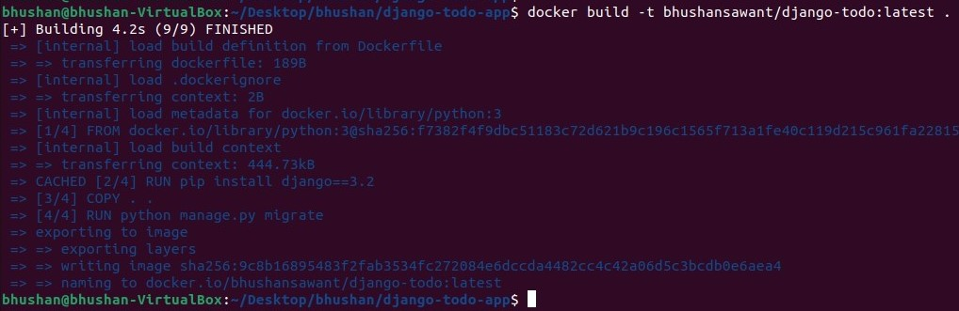
Setup and Manage Docker Containers

Slide 6
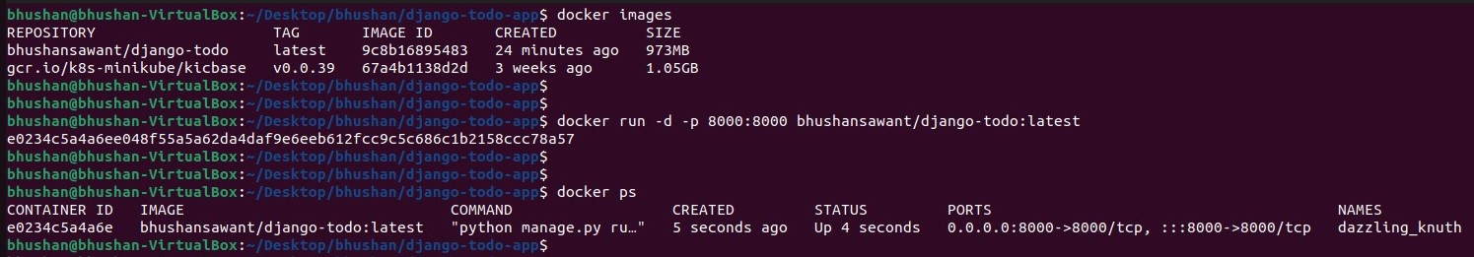

Slide 7
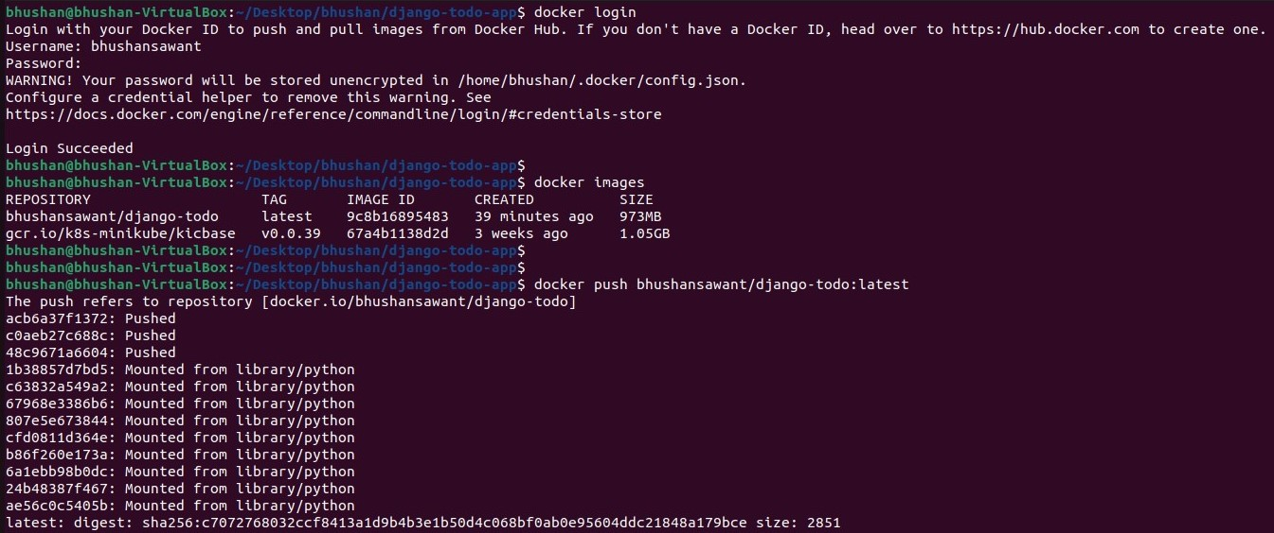

Slide 8
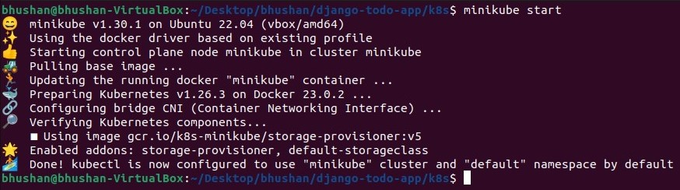
Creating pod:

Slide 9
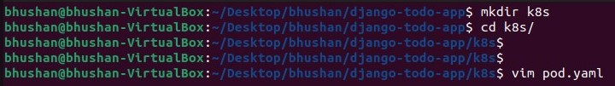
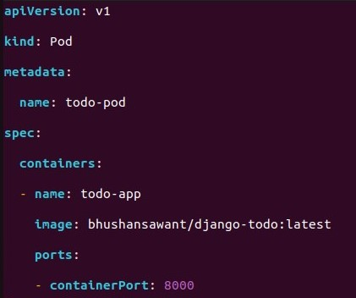

Slide 10
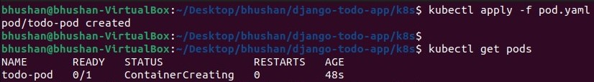

Slide 11
Creating Deployment:

Slide 12
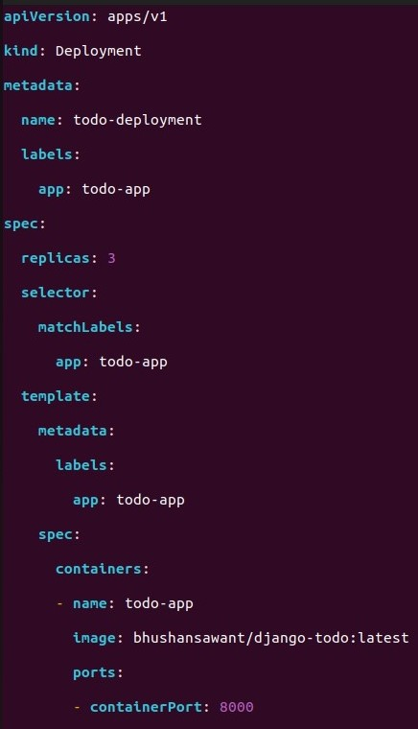

Slide 13
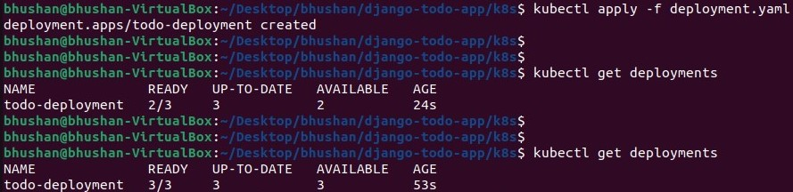

Slide 14
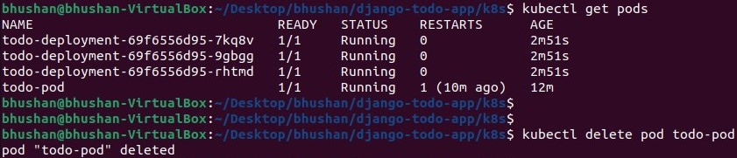
Deleting pod:

Slide 15
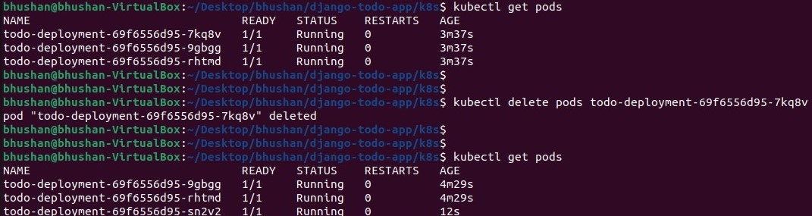

Slide 16
Creating Service:

Slide 17
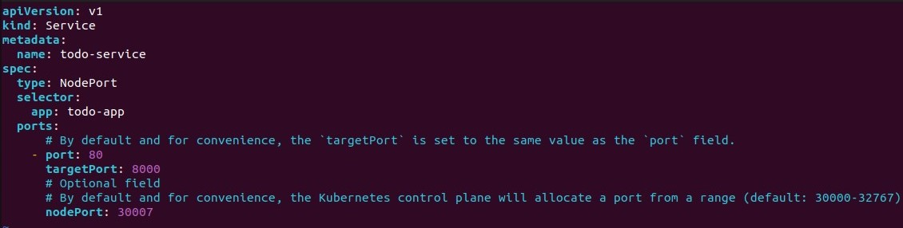

Slide 18
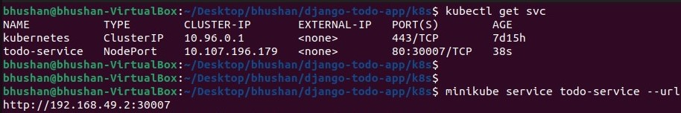

Slide 19
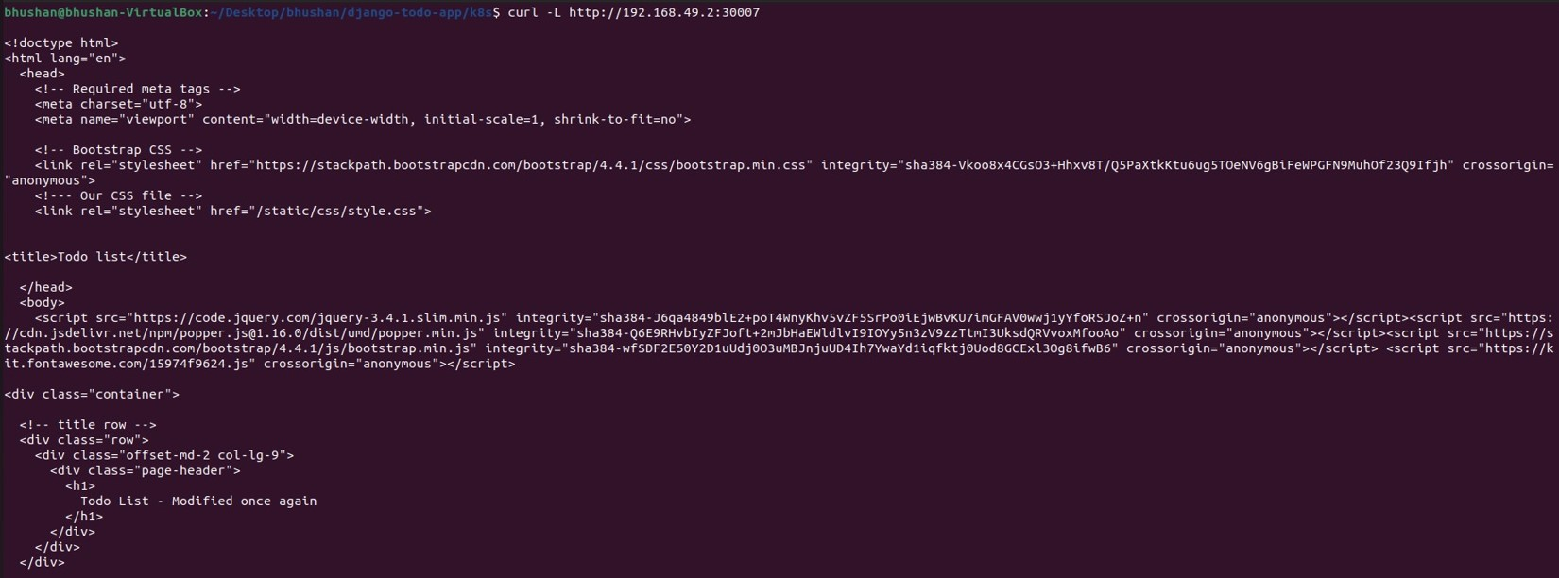

Slide 20
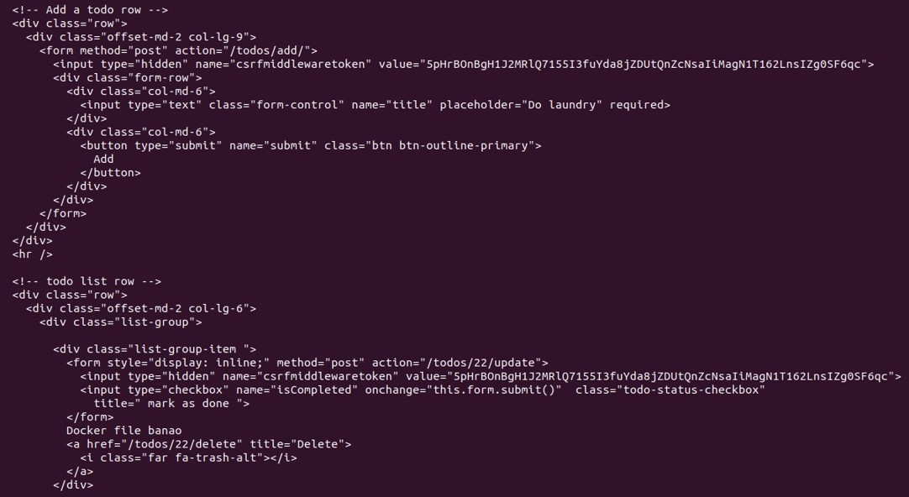

Slide 21
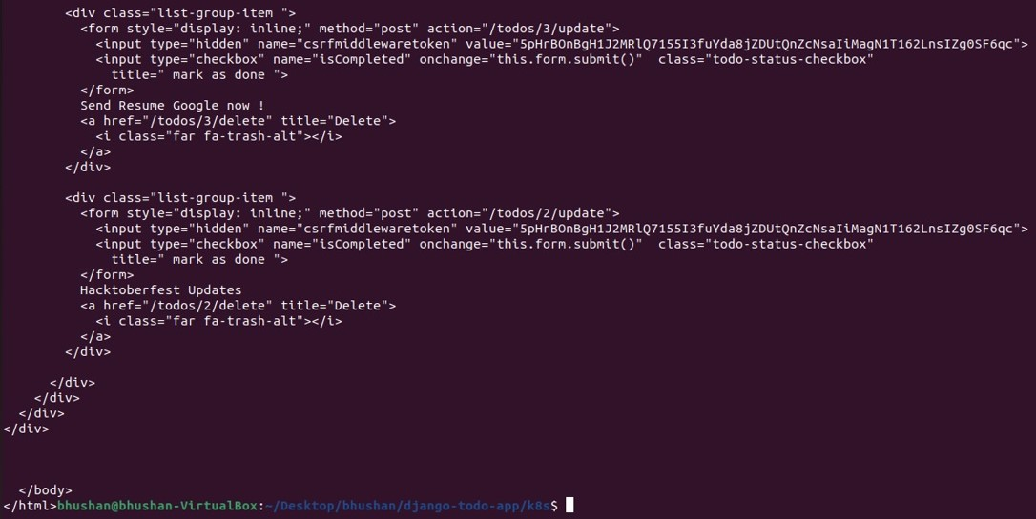

Slide 23
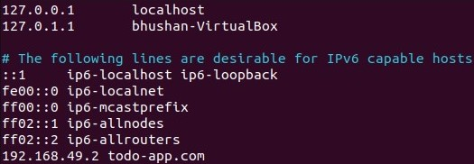

Slide 24
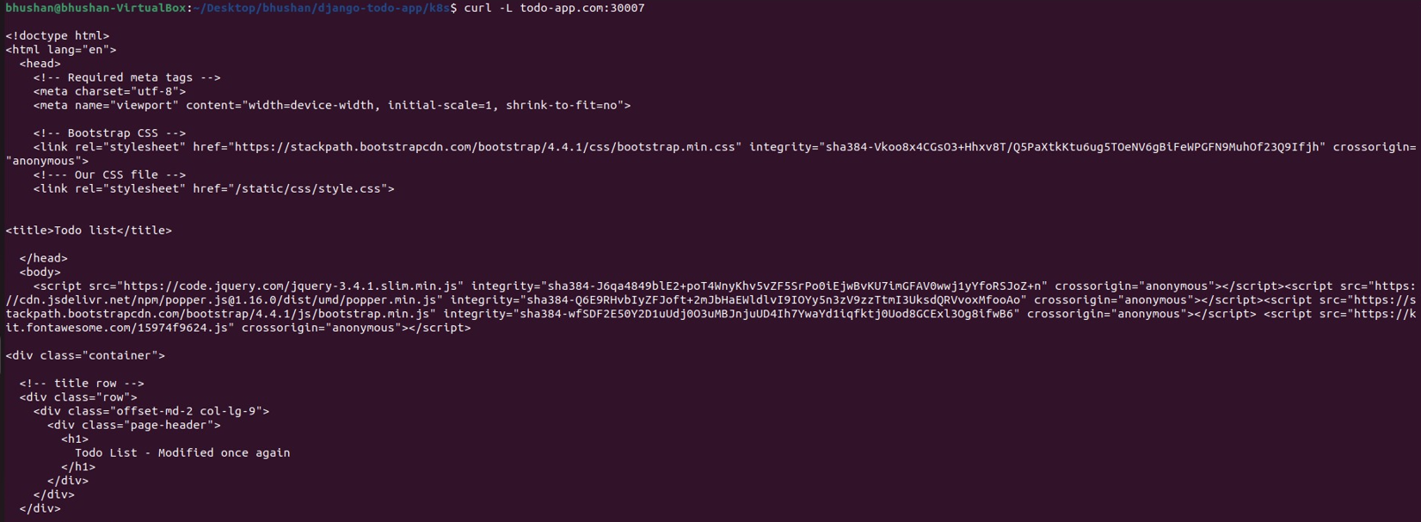

Slide 25
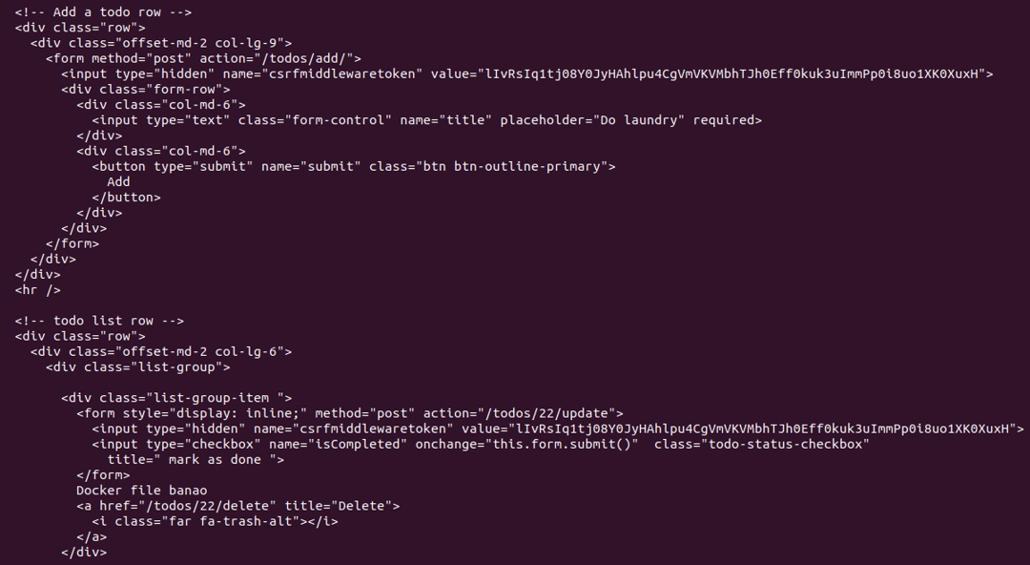

Slide 26
